Slide 1
CS2103 Software Engineering
Lecture 7

Slide 2
SKILLS
CTO
Architect
Team Lead
Software Engineer
Programmer
EXPERTISE

Slide 3
SKILLS
CTO
Architect
TOP-DOWN approach
Team Lead
Software Engineer
Programmer
EXPERTISE

Slide 4
UI
C
TOP-DOWN approach
B
UI
A
C
B

Slide 5
Lecture 7: Still doing detailed design, while getting more out of OO
1
2
3
4
5
6
11
10
9
8
7

Slide 6
Still doing detailed design, while getting more out of OO
Abstraction
Encapsulation
……………………
…………………….

Slide 7
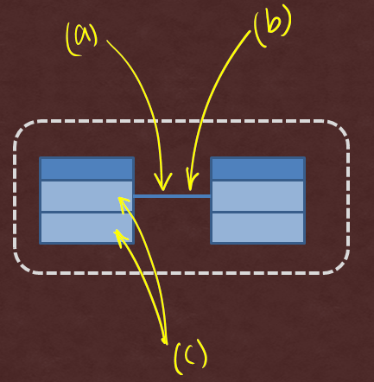
Student
Book
borrows
Student
Book
borrowed by

Slide 8
Student
Book
borrows
Where to put return date?

Slide 9
Student
Book
borrows
Student
Book
borrows
Loan
Association classes
returnDate

Slide 10
Student
Book
borrows
Student
Book
borrows
Loan
Association classes
returnDate
Student
Book
Loan
returnDate

Slide 11
Student
Book
borrows
Student
Book
borrows
Loan
Association classes
returnDate
Student
Book
Loan
returnDate

Slide 12
Student
Book
borrows
Student
Book
borrows
Loan
Association classes
returnDate
Student
Book
Loan
returnDate

Slide 13
Student
Book
borrows
Loan
returnDate
Chapter

Slide 14
Student
Book
borrows
Loan
returnDate
Composition
Chapter

Slide 15
Shelf
Student
Book
borrows
Loan
returnDate
Composition
Chapter

Slide 16
Shelf
Student
Book
borrows
Loan
returnDate
Composition
Chapter
Aggregation

Slide 17
Composition
Aggregation

Slide 18
Composition
Aggregation

Slide 19
Composition
Aggregation

Slide 20
Shelf
Student
Book
borrows
Loan
returnDate
Where to put total students?
Chapter

Slide 21
Class-level members
Shelf
Student
Book
borrows
-totalStudents
+getTotal()
Loan
returnDate
You mean I can say Student.getTotal() ?
Chapter

Slide 22
Shelf
Student
Book
borrows
-totalStudents
+getTotal()
Loan
returnDate
OK. Why not Student.totalStudents ?
Chapter
OK. Can I say Student.totalStudents ?

Slide 23
Still doing detailed design, while getting more out of OO
Abstraction
Encapsulation
……………………
…………………….

Slide 24
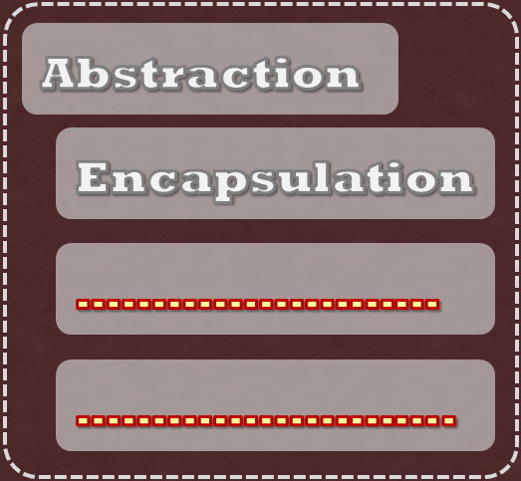
Example 1
I want to calculate age of Students
Here you go!
UGStudent
Admin
NGStudent
PGStudent

Slide 25
Example 1
Gaaah….!
UGStudent
Admin
NGStudent
PGStudent

Slide 26
Example 1
foreach Student s:
s.getAge();
…
Can?
Cannot!
UGStudent
Admin
NGStudent
PGStudent

Slide 27
Example 2
Storage s;
…
s.load();
…
Logic
Storage
setStorage(Storage)

Slide 28
Example 2
How?
TestDriver
Logic
Storage
setStorage(Storage)
StorageStub

Slide 29
Example 2
TestDriver
Logic
Storage
setStorage(Storage)
StorageStub
Dependency Injection

Slide 30
Example 2
Storage s;
…
s.load();
…
TestDriver
Logic
Storage
setStorage(Storage)
StorageStub
Storage s;
…
void setStorage(Storage s){
this.s = s;
}
Dependency Injection

Slide 31
Example 2
Storage s;
…
s.load();
…
TestDriver
Logic
Storage
setStorage(Storage)
StorageStub
Storage s;
…
void setStorage(Storage s){
this.s = s;
}
Dependency Injection

Slide 32
Treat multiple types as one type and still get different behavior
foreach Student s:
s.getAge();
…
TestDriver
Logic
Storage
setStorage(Storage)
StorageStub
UGStudent
Storage s;
…
void setStorage(Storage s){
this.s = s;
}
Admin
NGStudent
PGStudent

Slide 33
Polymorphism
Treat multiple types as one type and still get different behavior
foreach Student s:
s.getAge();
…
TestDriver
Logic
Storage
setStorage(Storage)
StorageStub
UGStudent
Storage s;
…
void setStorage(Storage s){
this.s = s;
}
Admin
NGStudent
PGStudent

Slide 34
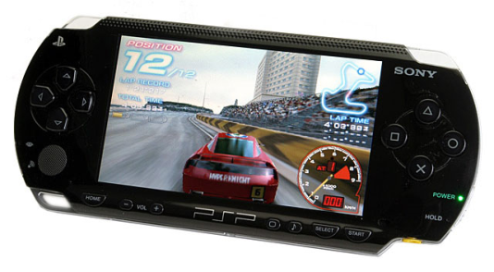
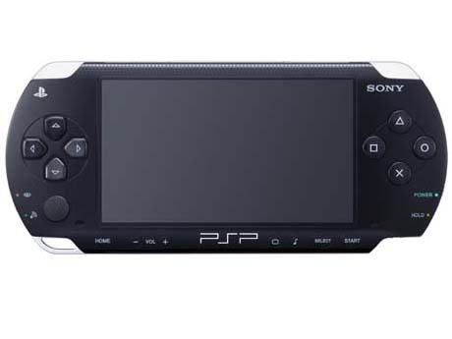
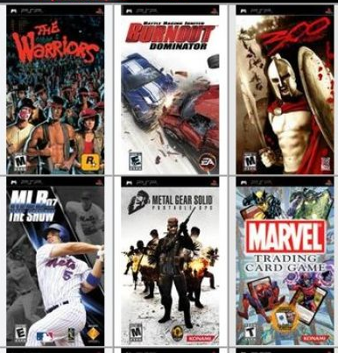
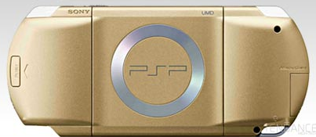
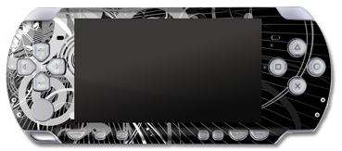
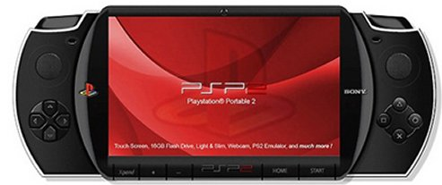
Polymorphism

Slide 35



Polymorphism
Different game, different behavior
Same hardware/ software

Slide 36
Polymorphism
= ability to take many forms

Slide 37
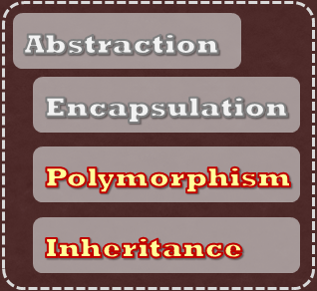

2
1
Inheritance
foreach Student s:
s.getAge();
…
UGStudent
*
Admin
Student
NGStudent
getAge()
PGStudent

Slide 38
2
1
Inheritance
foreach Student s:
s.getAge();
…
:UGStudent
UGStudent
*
Admin
Student
NGStudent
getAge()
PGStudent

Slide 39
2
1
Inheritance
is a
UGStudent
Student
NGStudent
getAge()
PGStudent

Slide 40
Q: Which ones show true inheritance?
Cat
Tiger
(a)
Animal
Dog
(d)
Camera
(b)
Wheel
iPhone
Car
Telephone
Engine
(c)
Book
Novel
TextBook

Slide 41
2
1
Inheritance
super class : sub class
Parent class : child class
UGStudent
Student
NGStudent
getAge()
PGStudent
specialization
Generalization

Slide 42
2
1
Inheritance
UGStudent
UGStudent
Student
NGStudent
NGStudent
NGStudent
getAge()
PGStudent
PGStudent

Slide 43
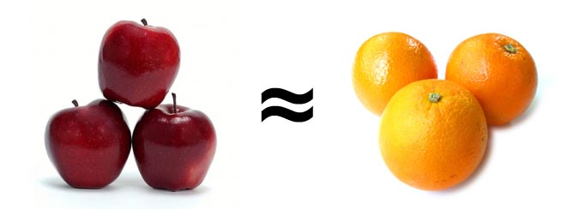
Find two things that are completely different and not similar in any way.

Slide 44
Java/C#: Single class hierarchy
Object
HelloWorld
Square
…
…
FilledSquare
C++: Many class hierarchies

Slide 45
2
1
Inheritance
foreach Student s:
s.getAge();
…
:UGStudent
UGStudent
*
Admin
Student
NGStudent
getAge()
PGStudent

Slide 46
2
1
Inheritance
foreach Student s:
s.getAge();
…
:UGStudent
UGStudent
*
Admin
Student
NGStudent
getAge()
PGStudent

Slide 47
2
1
If expecting super class, can accept sub class
Inheritance
foreach Student s:
s.getAge();
…
:UGStudent
UGStudent
*
Admin
Student
NGStudent
Substitutability
PGStudent

Slide 48

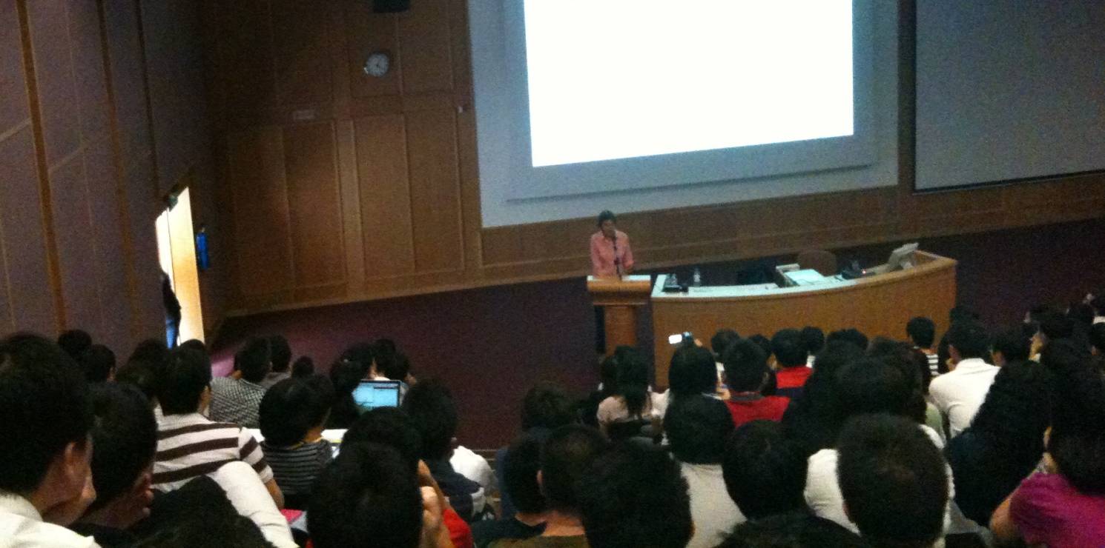
Based on Liscov Substitution Principle by Barbara Liskov
Substitutability

Slide 49
2
1
Inheritance
foreach Student s:
s.getAge();
…
:UGStudent
UGStudent
*
Admin
Student
NGStudent
PGStudent

Slide 50
2
1
Storage s;
…
void setStorage(Storage s){
this.s = s;
}
Inheritance
Storage
TestDriver
Logic
setStorage(Storage)
Logic logic;
…
logic .setStorage(new StorageStub() );
StorageStub

Slide 51
2
1
Storage s;
…
void setStorage(Storage s){
this.s = s;
}
Inheritance
FileStorage
Storage
TestDriver
Logic
DBStorage
setStorage(Storage)
load()
Logic logic;
…
logic .setStorage(new StorageStub() );
StorageStub
All ‘load’ the same way?

Slide 52
2
1
Inheritance
FileStorage
Storage
load()
TestDriver
Logic
DBStorage
setStorage(Storage)
load()
load()
Overriding
StorageStub
load()

Slide 53
2
1
At compile time…
Storage s;
…
s.load();
Inheritance
FileStorage
Storage
load()
TestDriver
Logic
DBStorage
setStorage(Storage)
load()
load()
Logic logic;
…
logic .setStorage(new StorageStub() );
StorageStub
load()

Slide 54
2
1
At run-time…
Storage s;
void setStorage(Storage s){
this.s = s;
}
Inheritance
TestDriver
Logic
:Logic
s:StorageStub
setStorage(Storage)
Logic logic;
…
logic .setStorage(new StorageStub() );

Slide 55
2
1
At run-time…
Storage s;
…
s.load();
Inheritance
FileStorage
Storage
load()
TestDriver
Logic
DBStorage
setStorage(Storage)
load()
load()
Logic logic;
…
logic .setStorage(new StorageStub() );
StorageStub
load()

Slide 56
2
1
At run-time…
Dynamic binding
Inheritance
FileStorage
Storage
load()
TestDriver
Logic
DBStorage
setStorage(Storage)
load()
load()
StorageStub
:Logic
s:??????????
load()

Slide 57
2
1
Storage s;
…
s.load();
Inheritance
Cannot!
FileStorage
Storage
load()
TestDriver
Logic
DBStorage
setStorage(Storage)
load()
load()
void load (){
//do nothing
}
StorageStub
Can remove?
load()

Slide 58
2
1
Inheritance
FileStorage
Storage
load()
TestDriver
Logic
DBStorage
setStorage(Storage)
load()
load()
All Storage objects should support a load method, but implementation is up to the child classes
StorageStub
load()

Slide 59
2
1
Inheritance
FileStorage
Storage
load()
TestDriver
Logic
DBStorage
setStorage(Storage)
load()
load()
abstract void load () ;
StorageStub
load()
virtual void load () = 0

Slide 60
2
1
Incomplete!
Cannot create objects!
Inheritance
FileStorage
Storage
load()
TestDriver
Logic
DBStorage
setStorage(Storage)
load() {abstract}
load()
StorageStub
load()

Slide 61
2
1
Abstract method/class
Inheritance
FileStorage
{abstract}
Storage
load()
TestDriver
Logic
DBStorage
setStorage(Storage)
load() {abstract}
load()
StorageStub
load()

Slide 62
2
1
Inheritance
FileStorage
{abstract}
Storage
load()
TestDriver
Logic
DBStorage
setStorage(Storage)
load() {abstract}
init()
store()
load()
StorageStub
load()

Slide 63
2
1
Inheritance
FileStorage
{abstract}
Storage
load(), init(), store()
TestDriver
Logic
setStorage(Storage)
load() {abstract}
init() {abstract}
store(){abstract}
DBStorage
load(), init(), store()
StorageStub
load(), init(), store()

Slide 64
2
1
Inheritance
FileStorage
<<interface>>
Storage
load(), init(), store()
TestDriver
Logic
setStorage(Storage)
load()
init()
store()
DBStorage
load(), init(), store()
StorageStub
load(), init(), store()

Slide 65
Interfaces
2
2
1
FileStorage
<<interface>>
Storage
load(), init(), store()
TestDriver
Logic
setStorage(Storage)
load()
init()
store()
DBStorage
load(), init(), store()
StorageStub
load(), init(), store()

Slide 66
Interfaces
2
2
1
Storage s;
void setStorage(Storage s){
this.s = s;
}
FileStorage
<<interface>>
Storage
load(), init(), store()
TestDriver
Logic
setStorage(Storage)
load()
init()
store()
DBStorage
load(), init(), store()
Logic logic;
…
logic .setStorage(new StorageStub() );
StorageStub
load(), init(), store()

Slide 67
Interfaces
2
2
1
class interface Storage {
public void load ();
public void init();
}
extends
class StorageStub implements {
…
}
FileStorage
<<interface>>
Storage
load(), init(), store()
load()
init()
store()
DBStorage
class Storage {
public:
virtual void load() = 0;
virtual void init() = 0;
};
load(), init(), store()
StorageStub
load(), init(), store()

Slide 68
Interfaces
2
2
1
Command cmd = createCommand(commandString);
cmd.exectute();
…
cmd.undo();

Slide 69
Still doing detailed design, while getting more out of OO
Abstraction
Encapsulation
Polymorphism
Inheritance

